Slide 1

Reinforcement Learning Meets Flappy Bird: A Colorful Exploration
Dive into the captivating world of Reinforcement Learning (RL) as we apply its powerful techniques to master the classic game of Flappy Bird. Prepare to soar through a vibrant, ever-changing landscape, where intelligent agents navigate challenges and strive for victory.
SK
by Shreyas Kashyap

Slide 2
The Agent: Navigating the Flappy Bird Universe
Observing the World
Taking Action
Learning and Adapting
The agent constantly perceives the game's state, analyzing its surroundings to make informed decisions.
With each flap of its virtual wings, the agent chooses the most advantageous course of action to progress through the game.
Through trial and error, the agent refines its strategies, learning from past experiences to optimize its performance.

Slide 3
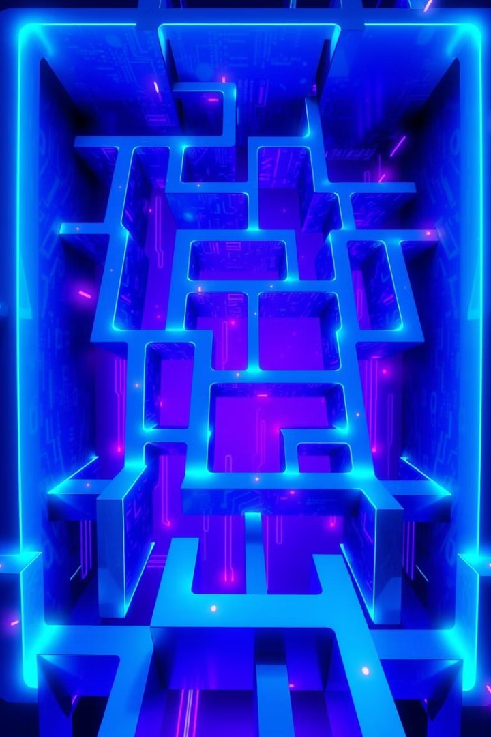
State Space: Defining the Game's Observations
1
Bird Position
2
Pipe Locations
The agent's vertical and horizontal coordinates within the game world.
The positions of the upcoming pipes that the agent must navigate through.
3
Velocity and Acceleration
4
Time and Score
The game's elapsed time and the agent's current score, providing valuable context.
The agent's current speed and rate of change, crucial for predicting its trajectory.

Slide 4

Actions: Flapping and Surviving
Flap
Do Nothing
Avoid Obstacles
The agent's primary action, applying an upward force to propel the bird upwards.
The agent can choose to refrain from flapping, allowing the bird to descend naturally.
The agent must learn to navigate through the pipes, making decisions to safely pass through the gaps.

Slide 5
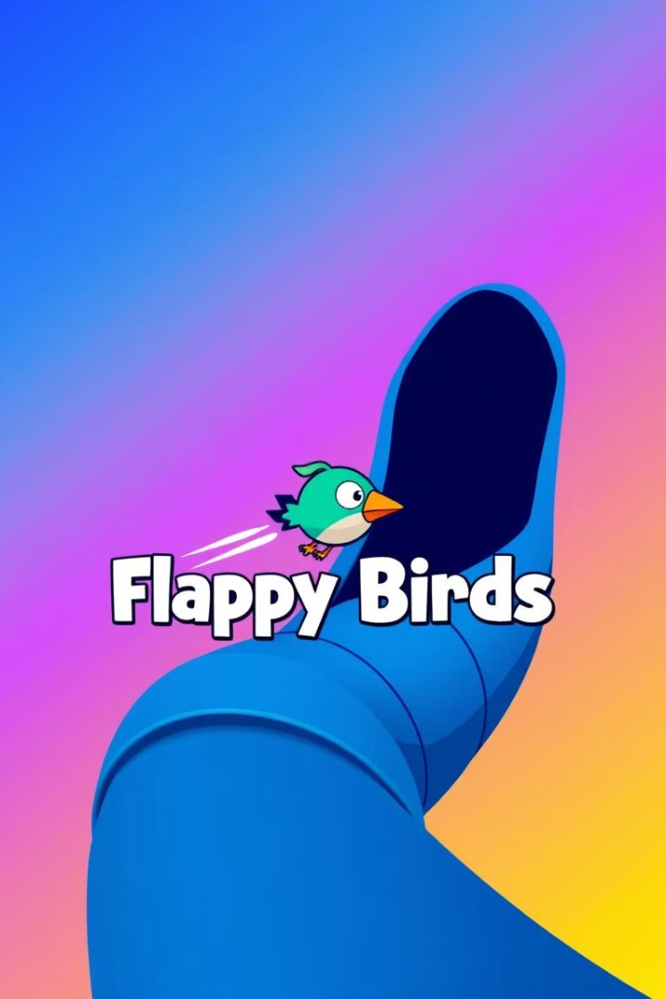



Rewards and Penalties: Scoring Points and Avoiding Obstacles
Score Points
The agent earns points for successfully passing through each pipe, motivating it to progress further.
Collide with Pipes
Crashing into the pipes results in a harsh penalty, encouraging the agent to learn how to avoid obstacles.
Survive Longer
Staying in the game for a longer duration earns additional rewards, incentivizing the agent to maintain control.

Slide 6




Value Function: Measuring the Long-term Rewards
Current State
The agent evaluates the immediate value of its current position and situation.
Future Reward
It also considers the potential long-term rewards that may result from its actions.
Value Function
The agent uses this value function to determine the most advantageous course of action.

Slide 7
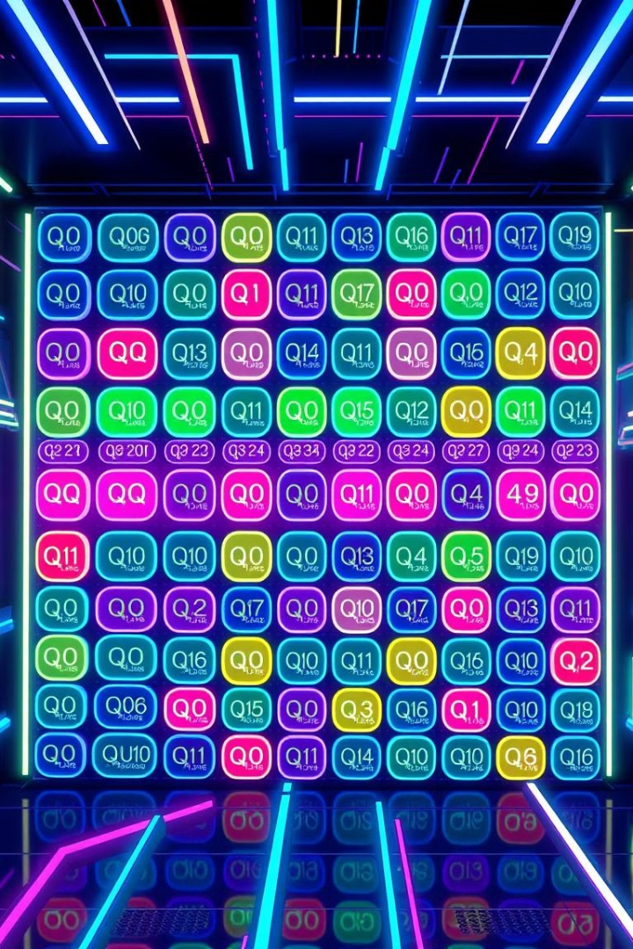
Q-Values: Estimating the Utility of Actions
Current State
Flap
Do Nothing
High Altitude
Avoid Pipes
Descend Safely
Low Altitude
Gain Altitude
Crash into Pipes

Slide 8
Policy: Deciding the Agent's Behavior
Exploration
Exploitation
Policy
The agent experiments with different actions to discover new, potentially more rewarding strategies.
The agent leverages its accumulated knowledge to choose the actions that are most likely to lead to success.
The agent's decision-making process, which balances exploration and exploitation to optimize its performance.

Slide 9
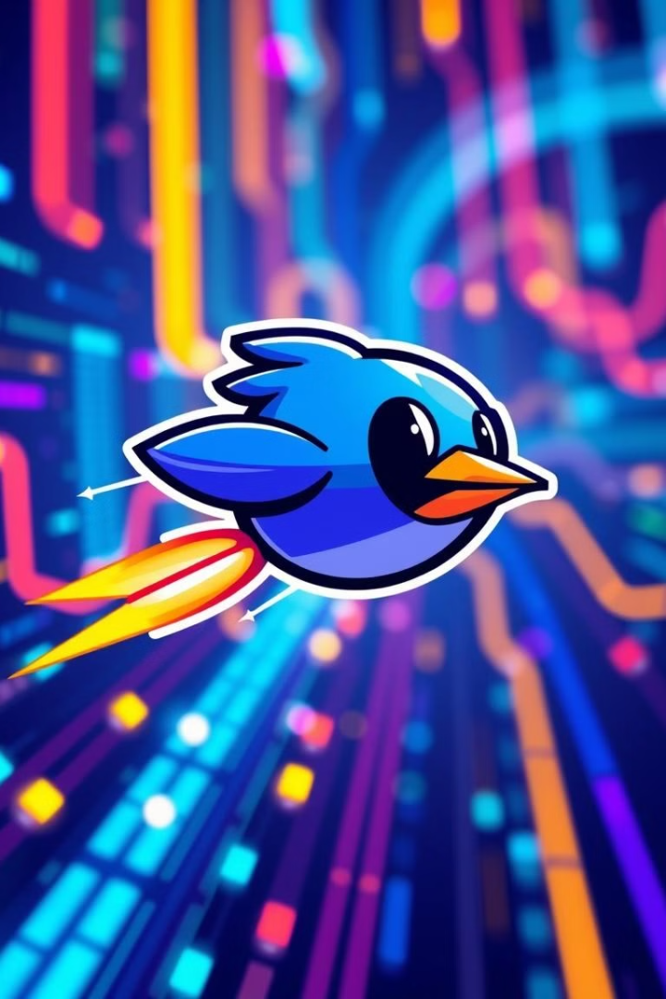
Training the Agent: Balancing Exploration and Exploitation
1
Initial Exploration
The agent starts by randomly trying various actions to gather information about the game's dynamics.
2
Gradual Exploitation
As the agent gains experience, it begins to favor actions that have proven more successful in the past.
3
Balanced Approach
The agent continuously adjusts its exploration-exploitation balance to optimize its long-term performance.

Slide 10

Conclusion: The Power of RL in Game AI
The integration of Reinforcement Learning into the classic Flappy Bird game showcases the immense potential of this technique in Game AI. By empowering agents to navigate complex environments, make strategic decisions, and learn from their experiences, RL unlocks new frontiers in the world of intelligent gaming.

